Slide 1

PROJ(CS)702
CSHB Model
Crypto-Steganographic
Hybrid Blockchain Model
for Network Security
Presented By:
1. Akash Kumar Sen
2. Arijit Mukherjee
3. Sandeep Shaw
4. Surajit Bera
(GCECTB-R19-3002)
(GCECTB-R19-3007)
(GCECTB-R19-3022)
(GCECTB-R19-3036)
Supervised By:
Dr. Bijoy Kumar Mondal
Assistant Professor Department of CSE, GCECT.

Slide 2

Contents
Abstract
Introduction
Literature Survey
Proposed Method
Algorithm Analysis
Working
Result Analysis
Future Scope
Reference
Conclusion
01
06
02
07
03
08
04
09
05
10

Slide 3



Abstract
The purpose concept of this project work is mainly focused on developing a secure and efficient model for data transfer between client and server that is end-to-end encrypted and promotes data integrity. This model is demonstrated using a simple text messaging application which provides assurance to the user by securing their data.
End-to-End Encrypted
Data Integrity
Strong Hashing & Encryption

Slide 4



Abstract
The idea here is to address two major data security threats that usually make any regular chat application vulnerable, the former is the Man in the Middle Attack (MITM Attack) and the latter is an incident of Data Breaching.
Man in the Middle Attack
Data Breaching

Slide 5

Introduction
We are living in the modern era of computers, smartphone and internet where most of our activity is digitalized and is performed online.
The information on every aspects of our lives are being uploaded and transferred through internet.
Multiple digital transaction occur within splits of seconds as our data is uploaded and transferred through the computer networks via internet.
Moreover, it is also important to secure the privacy as confidential online transaction or information might be accessed or manipulated by the attackers or any other third party attacks. Therefore to protect the data, the role of network security comes into action and to prioritize safety of confidential information across the network.

Slide 6

Introduction
In this project, we have proposed to build a secure and efficient model for data transmission between client and server and secure method of data storage in the server.
This model will be illustrated using a text messaging application which will include
Secure Hashing
Advance Cryptography
Steganography
Some concept of Blockchain with existing Database
Together it will be used to store and retrieve the message data in a more secure manner by protecting the data from MITM Attack, Data Spilling, Strong resistance to Brute Force and Side Channel Attack

Slide 7

Literature Survey
In this section, we provide a brief literature review on recent progress in techniques with a focus on secure data encryption, effective steganography methods, and compatible block-chained data integrity.
As of now, the AES is unbreakable, however, potential problems exist in AES-128 and AES-256. AES-256 is less susceptible to brute force attack but undergoes weak key schedule as compared AES-128. The side channel attack and new process of attacks is combined for boomerang and rectangle attacks. This uses the weaknesses of a few nonlinear transformations in the key schedule algorithm of ciphers and it can break some reduced-round versions of AES.

Slide 8

Literature Survey
Data retrieval from stego-object via LSB image steganography is straightforward and data can be easily manipulated or accessed by the attacker. Therefore the data should be encrypted, image should be dynamically chosen to avoid less padding with high throughput and field for error detection.
The emergence of creating a hybrid model similar to blockchain which supports the feasibility to check data integrity without affecting the speed by using the traditional database approach. The main disadvantage of using blockchain technology is that as the size of the data increases the time complexity to verify every transaction also increases.

Slide 9
Proposed Method
The principle idea is to construct a model where at various phases of data transmission from client to server and vice-versa, a specific algorithm is utilized to secure the data. This algorithm includes hashing, dynamic crypto-steganography, and the use of hybrid blockchain database storage.
Thus this model of various algorithms is used to implement a text messaging app system that provides a secure data transfer from the client to the server and stores that particular data inside the database such that the integrity of data is conserved.
Constant Key Storing
Hashing & Dynamic Encryption
Image Steganography
Storing Data to Server
Fetching Data from Server

Slide 10
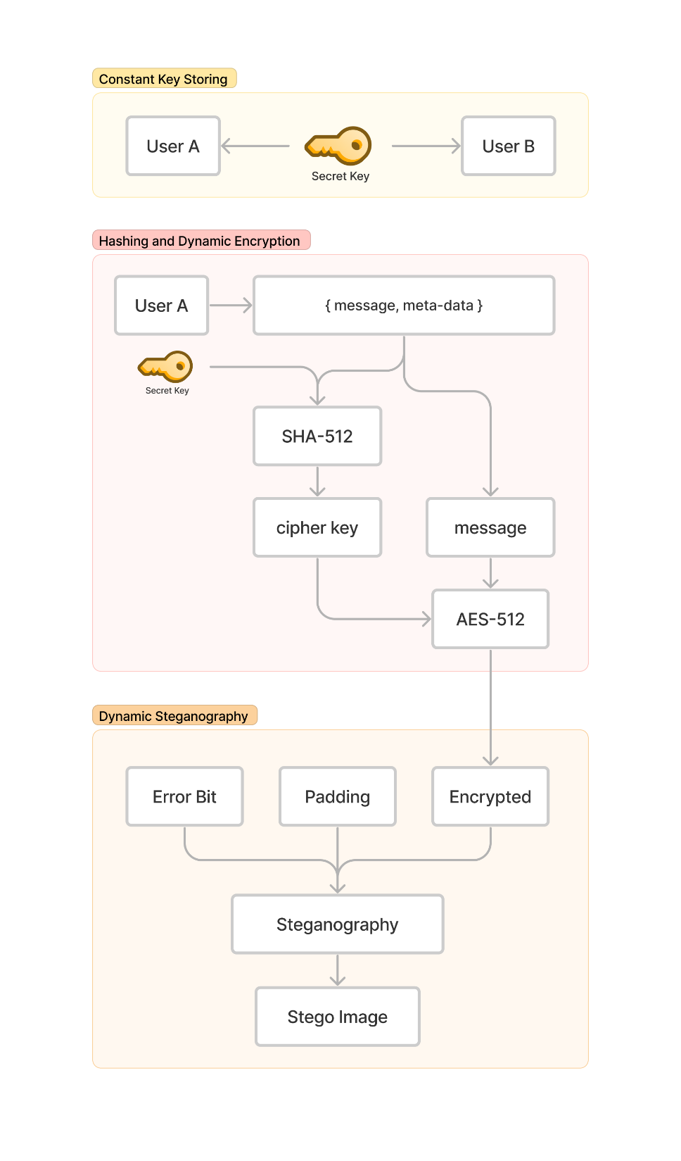
Constant Key Storing
First of all the users of the chatroom will share a common and consistent secret code generated randomly when the chatroom is established.
Depending on the nature of security these secret code may be stored either in user's device in decentralized manner or inside more secure layered database in centralized manner.
External Hardware Security
Different Server
Same Database
Cloud Storage

Slide 11
Constant Key Storing
Hashing & Dynamic Encryption
The secret key combined with other fields of the message will be used to generate a hash value using Secure Hash Algorithm (SHA-512)
Then this hash value generated above is used as a symmetric key for the Advance Encryption Standard algorithm (AES) to encrypt the message.

Slide 12
Image Steganography
Constant Key Storing
According to the length of the encrypted message, a particular image of given dimensions will be calculated and used for the effective embedding of data inside the image. Then the Stego-object is sent to the server via API.

Slide 13
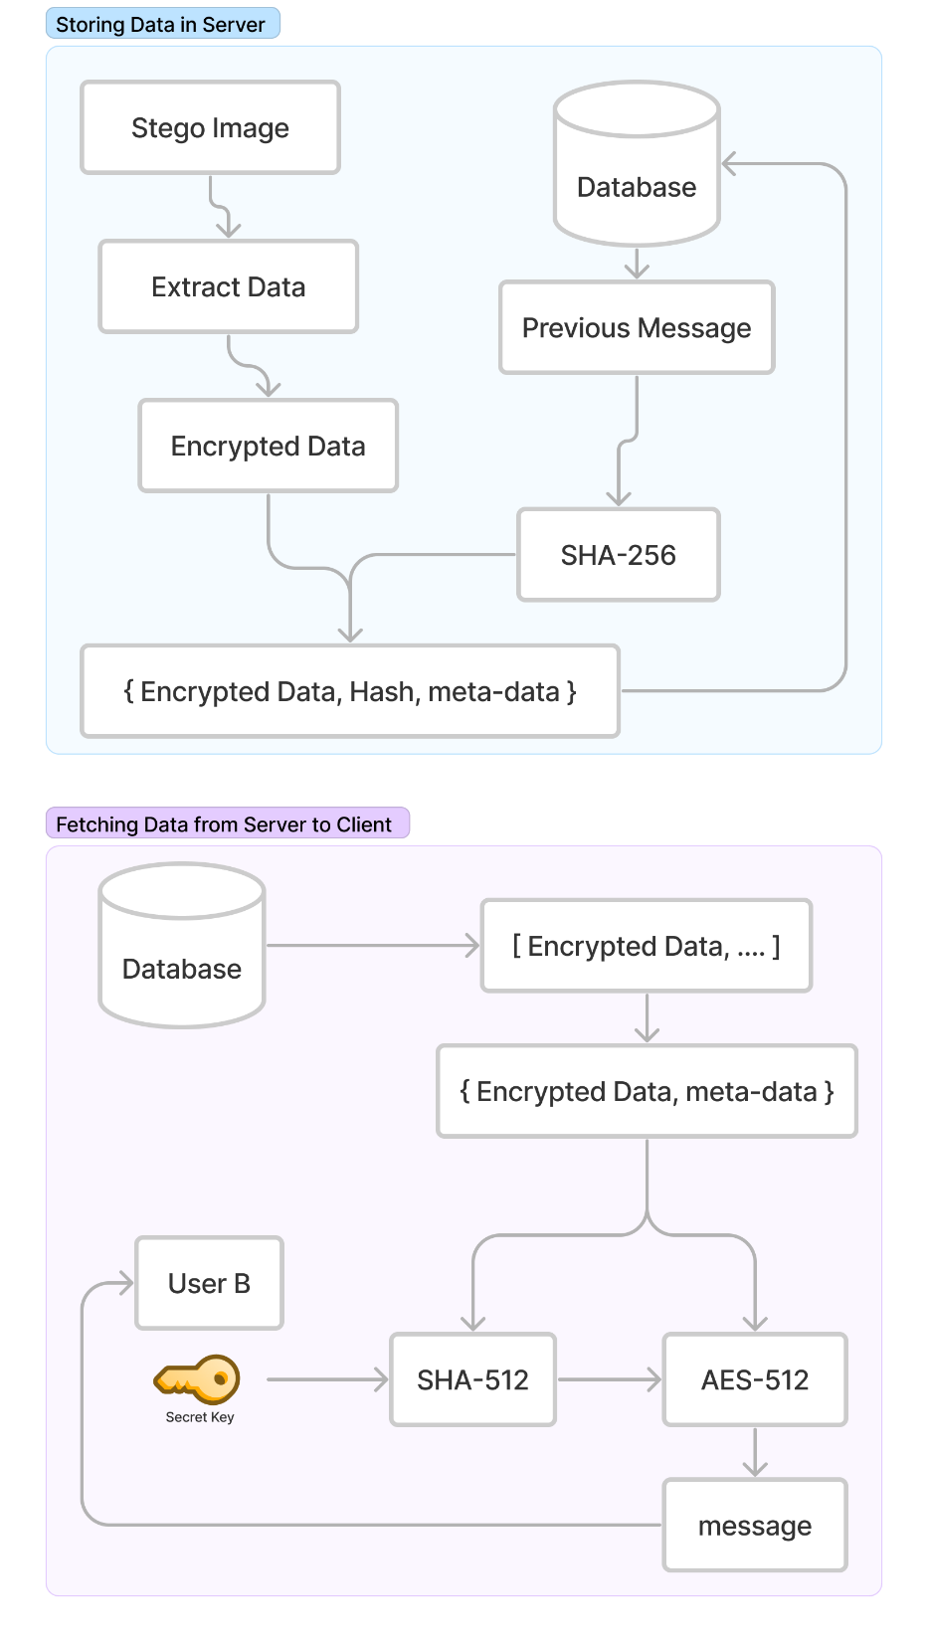
Constant Key Storing
Storing Data to Server
At the server, the message is extracted from Stego-object which outputs the encrypted message.
This data is fetched and stored inside the database. While storing the encrypted message in a database, the traditional database is perform and additional partial blockchain function by linking the hash of the previous messsage in the same chat room with the current message id using any Secure Hashing Algorithm.

Slide 14
Constant Key Storing
Fetching Data from Server
The chat data can be retrieved in bulk from the server to the client. As the data was stored in encrypted format therefore it is still secure and at the client side the chat will be decrypted.
The symmetric key can be obtained using the constant secret key and other attributes of the message which is passed to the AES and the plain text is obtained from the cipher text and is rendered on the screen.

Slide 15

Algorithm
SHA3-512
Base64 Encoding
AES-512 with 512 bits state
LSB Image Steganography
Hybrid Blockchain

Slide 16
SHA3-512
Base64 Encoding

Slide 17
LSB Image Steganography
SHA3-512
Hybrid Blockchain

Slide 18
AES-512 with 512 bits state

Slide 19
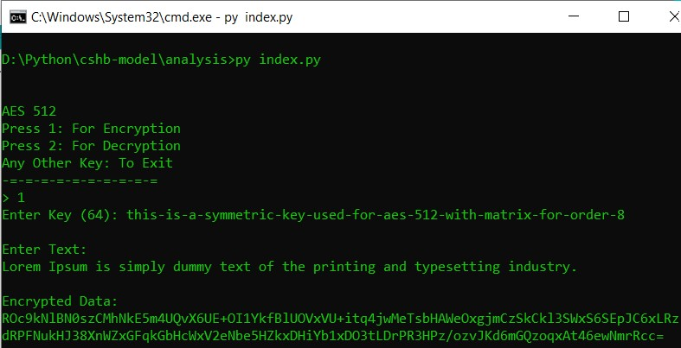
Working

Slide 20
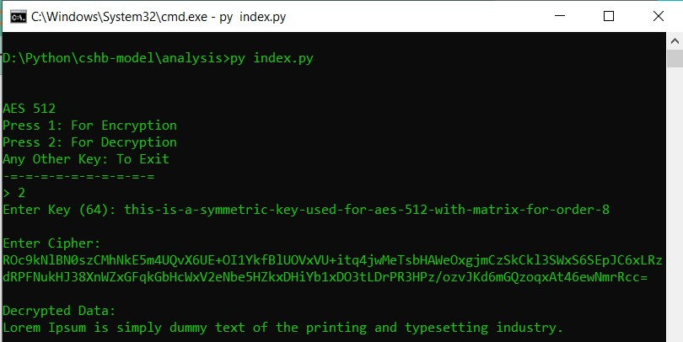
Working

Slide 21
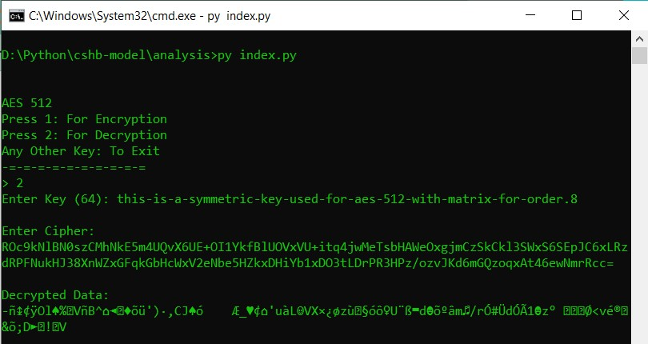
Working

Slide 22
Analysis
Atleast 5 page Add

Slide 23

Future Scope
Optimization of existing AES-512 algorithm by grouping different operations in a round and implementing dynamic programming.
Methods to increase more variation for round keys in key scheduling for AES-512 with an attempt to bring it more closer to AES-128.
Dynamic LSB Steganography implementation with an additional space for error bits to successfully detect manipulation of the data with higher accuracy.
Implementation of data schemas at server with additional features of blockchain by storing hash values. Comparing better alternatives for this implementation either using No-SQL (Firebase/MongoDB) or Relational SQL (Supabase/MySQL/Sqlite3).

Slide 24

Reference
[1] Yeuan-Kuen Lee, Graeme Bell, Shih-Yu Huang, Ran-Zan Wang, and Shyong-Jian Shyu: “An Advanced Least-Significant-Bit Embedding Scheme for Steganographic Encoding”, 2009.
[2] “Applied Cryptography Protocols, Algorithms, and Source Code in C”, A book by Bruce Schneier.
[3] H. Gilbert and M. Minier, “A collision attack on seven rounds of Rijndael”, Proceedings of the 3rd AES Candidate Conference, (2000) April: 230-241.
[4] B. Schneier, “The GOST Encryption Algorithm”, Dr. Dobb’s Journal, v.20, n. 1, (1995) January: 123-124.
[5] "Data security using 512 bits symmetric key based cryptography in cloud computing system", Bijoy Kumar Mandal, Debnath Bhattacharyya and Xiao-Zhi Gao, (2019)
[6] “Efficient High-Performance FPGA-Redis Hybrid NoSQL Caching System for Blockchain Scalability”, Abdurrashid IbrahimSankaMehdi Hasan Chowdhury Ray C.C.Cheung, 2021.

Slide 25
Reference
[7] “The Design of Rijndael AES – The Advanced Encryption Standard”, a book by Joan Daemen, Vincent Rijmen, November 26, 2001.
[8] “AES 512: 512-bit Advanced Encryption Standard Algorithm Design and Evaluation”, Abidalrahman Moh’d and Yaser Jararweh Lo’ai Tawalbeh.
[9] “Ease of Side-Channel Attack on AES-192/256 by Targeting Extreme Keys”, Antonie Wurcker.
[10] “Side Channel Power Analysis of an AES-256 Bootloader”, Colin O’Flynn and Zhizing (David) Chen.
[11] "A Cost analysis of AES-128 and AES-512 on Apple mobile processors", Vatchara Saicheur and Krerk Piromsopa

Slide 26

Akash Kumar Sen
GCECTB-R19-3002
Arijit Mukherjee
GCECTB-R19-3007
Sandeep Shaw
GCECTB-R19-3022
Surajit Bera
GCECTB-R19-3036
THANK YOU

Slide 27
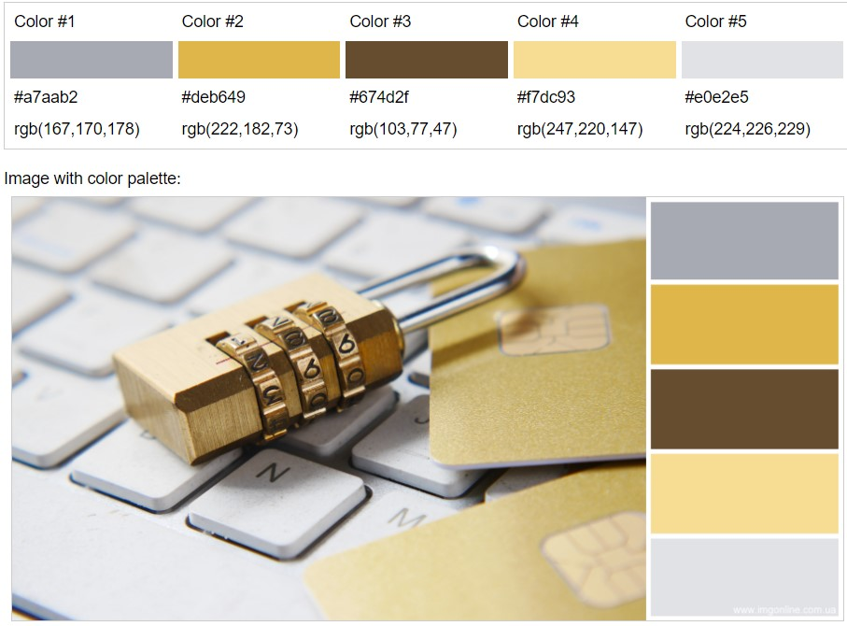
Fonts:
Verdana

